Slide 1
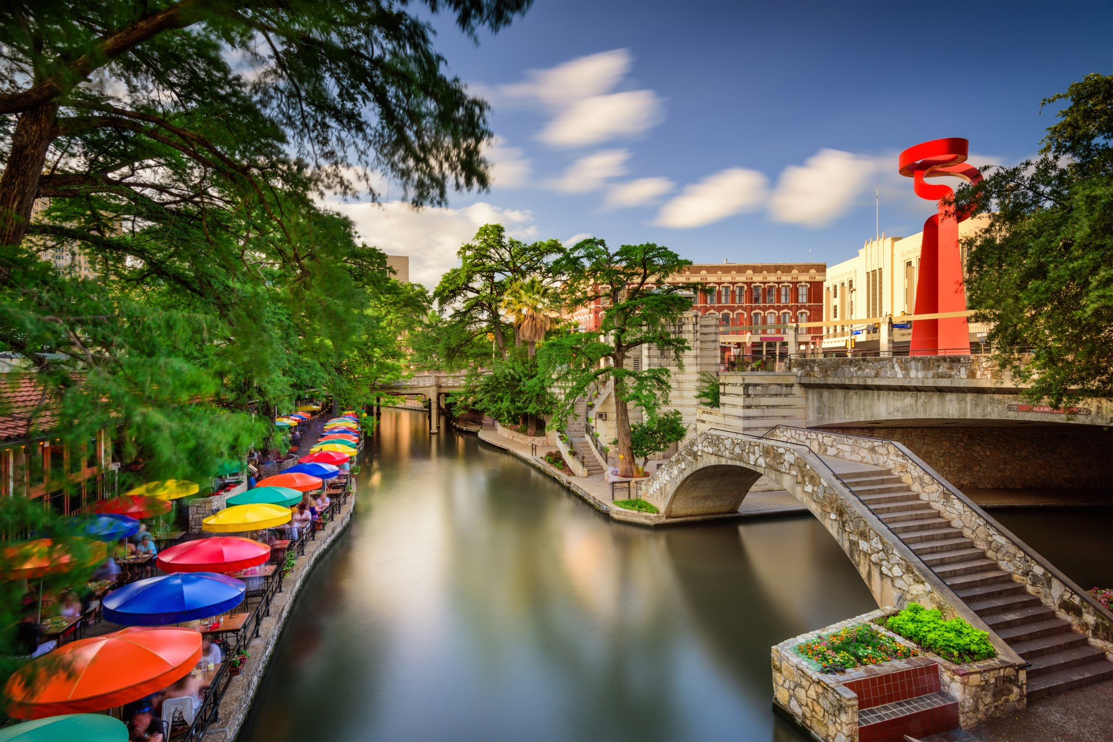
Bringing Another Professional Sports Team to San Antonio

Slide 2
Why?
Have population and land area to have another team.
San Antonio people have proven to be loyal sports fans and deserve another professional sports team.
Revenues would or could be very satisfactory.
In summary, great location, great fans and great earning potential.

Slide 3
Data Acquisition and Cleaning
Population Information: https://en.wikipedia.org/wiki/List_of_United_States_cities_by_population
Sports Teams Information: http://www.stadium-maps.com/facts/sports-franchises.html
San Antonio Neighborhood Information: https://sanantonio.areaconnect.com/zip2.htm?city=San+Antonio
Revenue Information: https://www.morssglobalfinance.com/major-league-baseball-finances-what-the-numbers-tell-us/
Scrapped and Cleaned Information into 3 tables to use for my analysis.

Slide 4
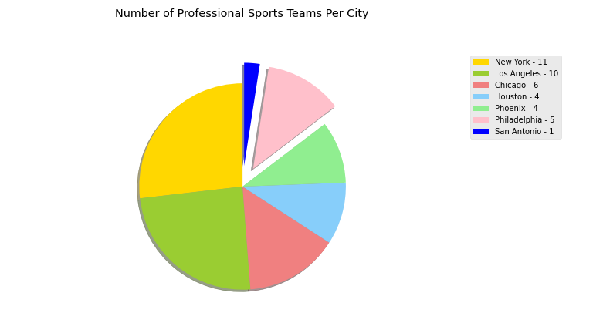
City vs Sports Teams Comparison

Slide 5
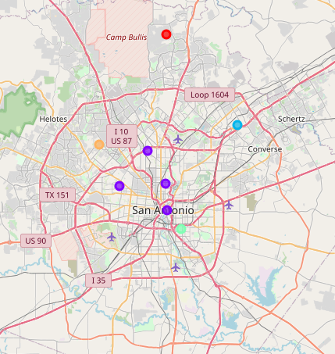
Location

Slide 6
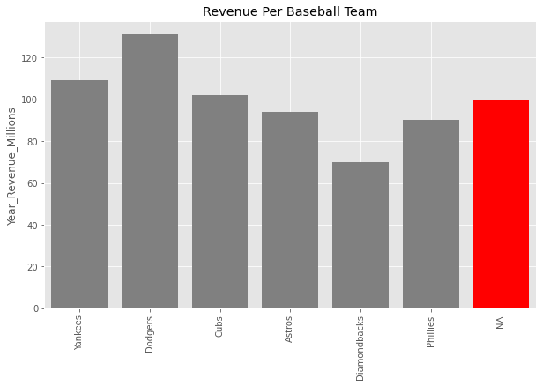
Potential Revenue For MLB Team

Slide 7
Discussion
Do you agree?
Possibility of expansion/draft a team.
Possibility of moving a team from another city.

Slide 8
Conclusion
San Antonio is a great city for another professional sports team.
Great location.
Great fans.
Great earning potential.

Slide 9

Questions

Slide 10
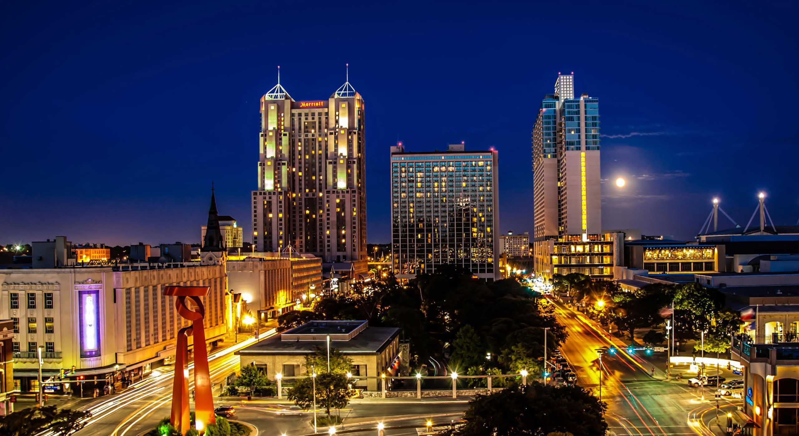
Thank you!!!

